Slide 1

#XamExpertDay
Welc me

Slide 2
Agenda
09:10 - 09:40
Keynote by Laurent Bugnion: Azure Functions and Xamarin
9:40 - 10:20
Skynet activated – Building smarter apps with Cognitive Services and Xamarin
10:30 - 11:20
Is your app secure?
11:40 - 12:20
Learn by doing! – Xamarin Workbooks
12:20 - 13:30
Lunch
13:30 - 14:20
Get Hungry for ReactiveUI with Xamarin Form
14:30 - 15:20
Realm, the cool new kid in Xamarin town
15:30 - 16:20
Building Cloud native mobile apps with Azure & Xamarin
16:30 - 17:20
Learn how to create custom views on Android using best practices, avoiding GPU overdraw, slow animations and more
17:25 - ...
Closing keynote, socializing and drinks 🍻

Slide 3
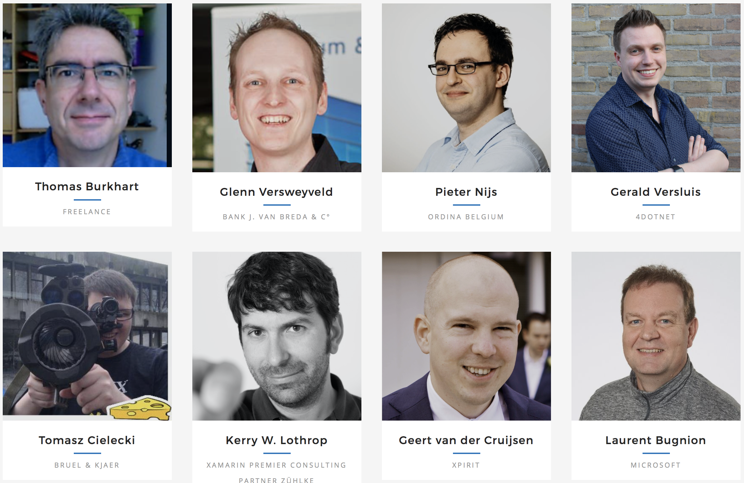
Speakers

Slide 4
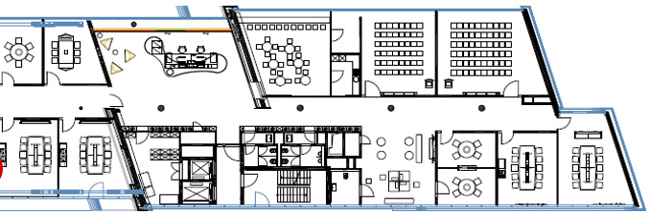
Floorplan
Main Conference
1
2
Breakout Sessions

Slide 5
Local Usergroups
Xamarin User Group Cologne
https://www.meetup.com/Xamarin-Cologne-User-Group/
Düsseldorf Xamarin Cross-Platform Group
https://www.meetup.com/Dusseldorf-Xamarin-Cross-Platform/
.net user group Köln
https://www.meetup.com/net-user-group-koeln/

Slide 6




Sponsors

Slide 7
Misc
WIFI
connect to MSFTGUEST
Event Attendee Code is msevent23sj
The official hashtag for the Conference: #XamExpertDay

